Slide 1
UNCERTAINTY QUANTIFICATION OF AGENT-BASED MODELS WITH APPLICATION TO MALARIA INTERVENTION MODELING
PhD Update
February 2025

Slide 2
Aim
To quantify and propagate the uncertainty from various parameters in the OpenMalaria Ghana model, beyond just the entomological inoculation rate (EIR) and to determine the impact of these uncertainties on simulating the effect of malaria interventions at the sub-national level.

Slide 3
Uncertainty Quantification can be classified in two forms
The field of Uncertainty Quantification offers a means of quantifying and characterizing uncertainties in models and the real world.
Forward Propagation of Uncertainty
Investigates the impacts of random input values of model parameters on model outputs
Inverse Uncertainty Quantification
using experimental data to learn about the sources of modeling uncertainty
Sensitivity Analysis
Model Calibration

Slide 4
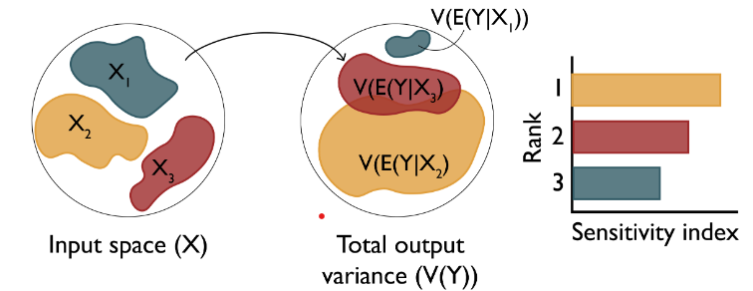
Research Objectives
Objective 1: Understand the key drivers of impact of malaria interventions in Ghana
Objective 3: Simulate the impact of malaria interventions in Ghana in order to support decisions for strategic planning
Objective 2: Develop a novel inference framework for calibrating the OpenMalaria model at a higher spatial resolution
Perform sensitivity analysis of coverage, halflife of efficacy and vector composition towards prevalence reduction and clinical cases averted (Forward Propagation of uncertainty)
Source: Sensitivity Analysis: The Basics

Slide 5
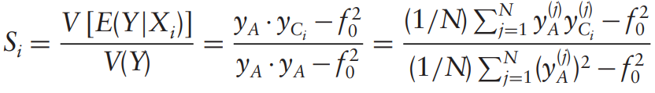
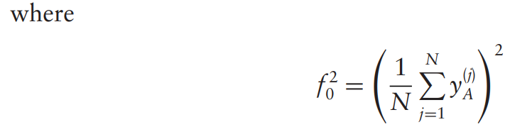
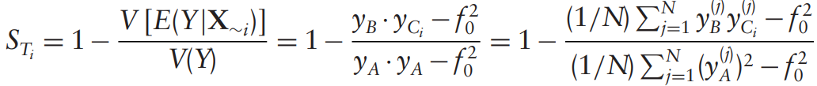
Variance-based sensitivity analysis (Sobol)

Slide 6
Objective 1 – Modifying the existing workflow
Chose a sampling scheme to reduce number of OM simulations and runtime
How do we reduce the number of OM simulations in order to drastically reduce runtime?
Tried other sampling designs instead of sweeps
Trained GP model on EIR, intervention coverages, prevalence reduction and used model for prediction while performing sensitivity analysis
Choose a sensitivity method (compared soboljansen and sobolsalt)
Notes:
To address uncertainties, we identify and quantify the various sources of uncertainty in intervention modeling

Slide 7
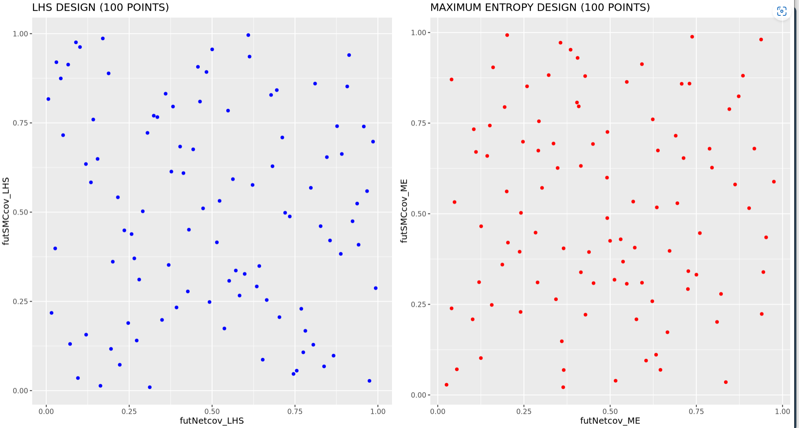
1 – LHS vs MED SAMPLING (100 POINTS)
LHS or ME sampling during simulation setup cuts runtime drastically

Slide 8
1 – LHS or ME sampling during simulation setup cuts runtime drastically
SETTING | NUMBER OF SIMULATIONS REQUIRED (SWEEPS) | NUMBER OF SIMULATIONS REQUIRED (LHS) | R-SQUARED | NUMBER OF X_COLS | GP TRAINING TIME (mins)
UPPER.EAST4 | 50K (submitted) | 1500 | 0.97 (sweep) | 4 | 11.9
OTI | 300000 (not submitted) | 2500 | 0.96 (LHS) | 4 | 1.9
BONO.EAST (no_LSM) | 212500 (not submitted) | 2000 | 0.95 (LHS) | 4 | 1.4
Notes:
LLINs is the most influential in determining the output variance

Slide 9
2 – GP performance evaluation - learning of prevalence reduction gives good statistical correspondence Actual vs predict for 3 settings: full EIR sweep for UE and LHS for Oti and BE
The GP was trained using all simulation data
Model performance was evaluated using R-sqaured
Notes:
LLINs is the most influential in determining the output variance

Slide 10
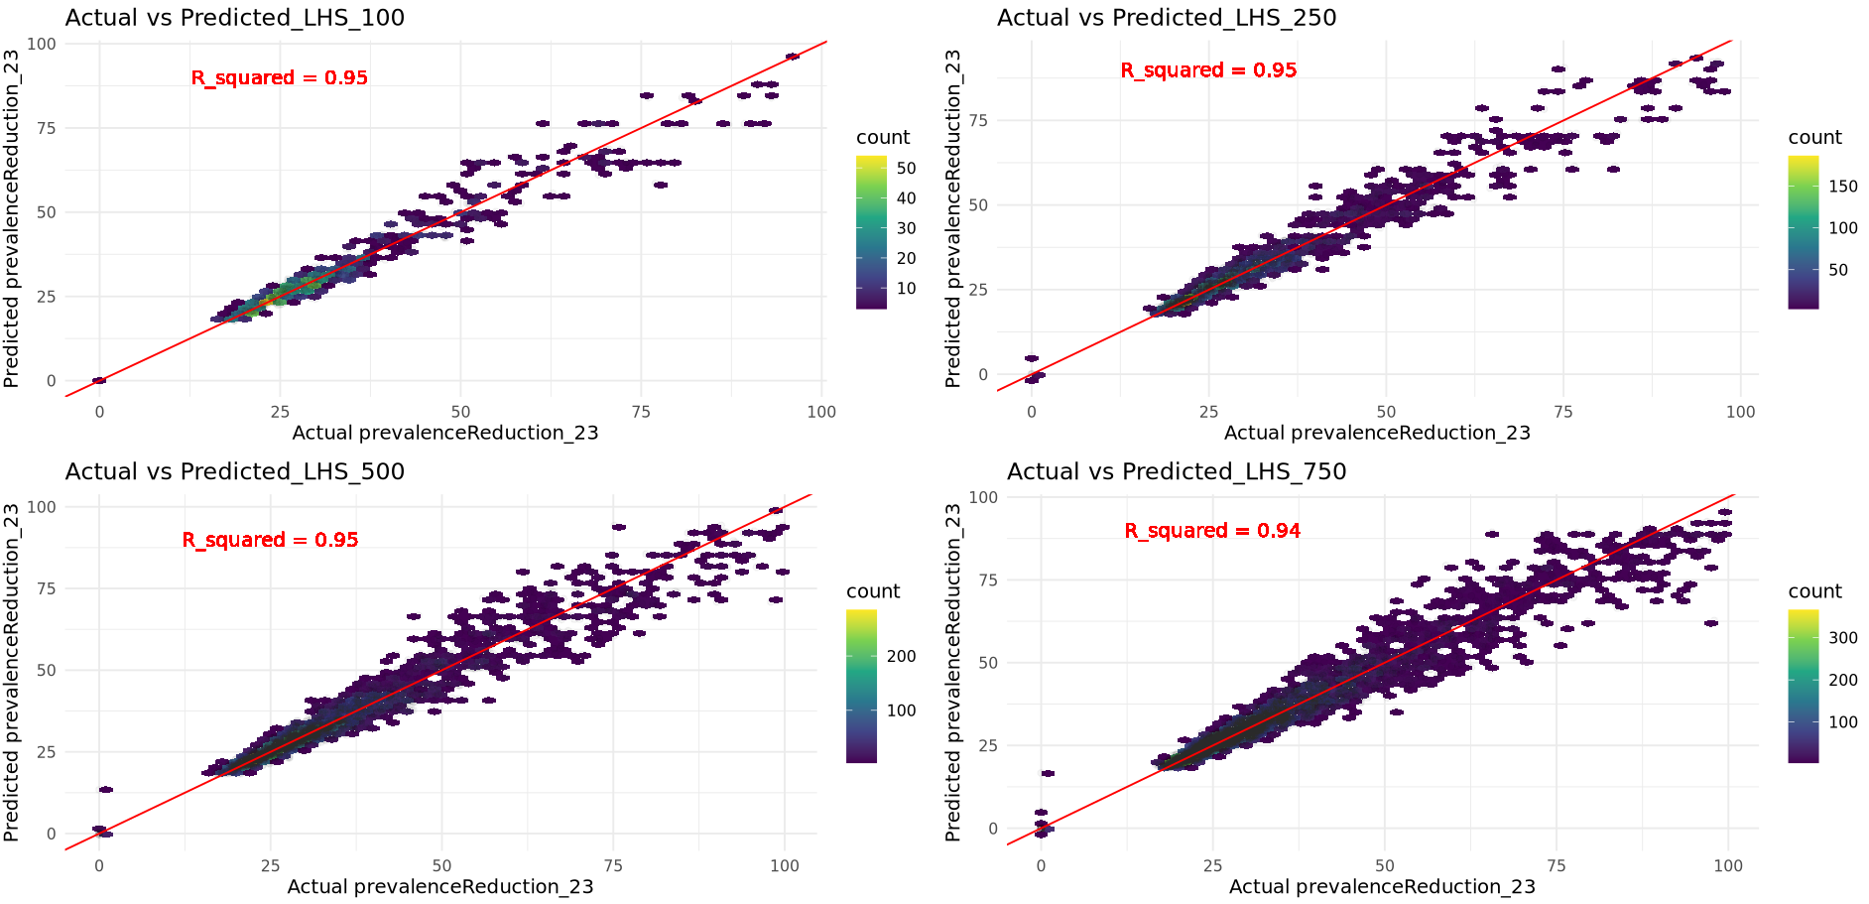
2 – GP performance evaluation - learning of prevalence reduction gives good statistical correspondence Actual vs predict using different LHS sample sizes for UE4
The GP was trained using all simulation data
Model performance was evaluated using R-sqaured
Notes:
LLINs is the most influential in determining the output variance

Slide 11
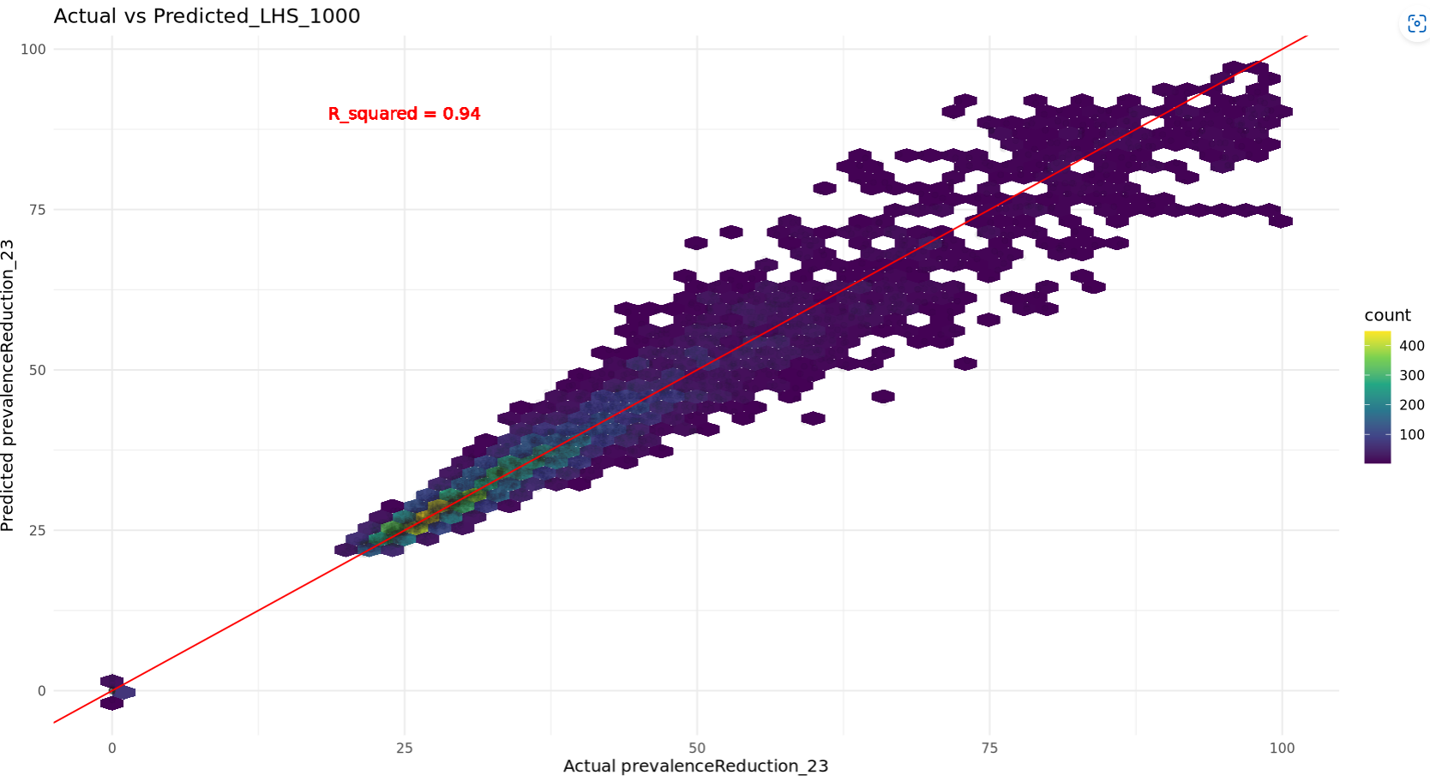
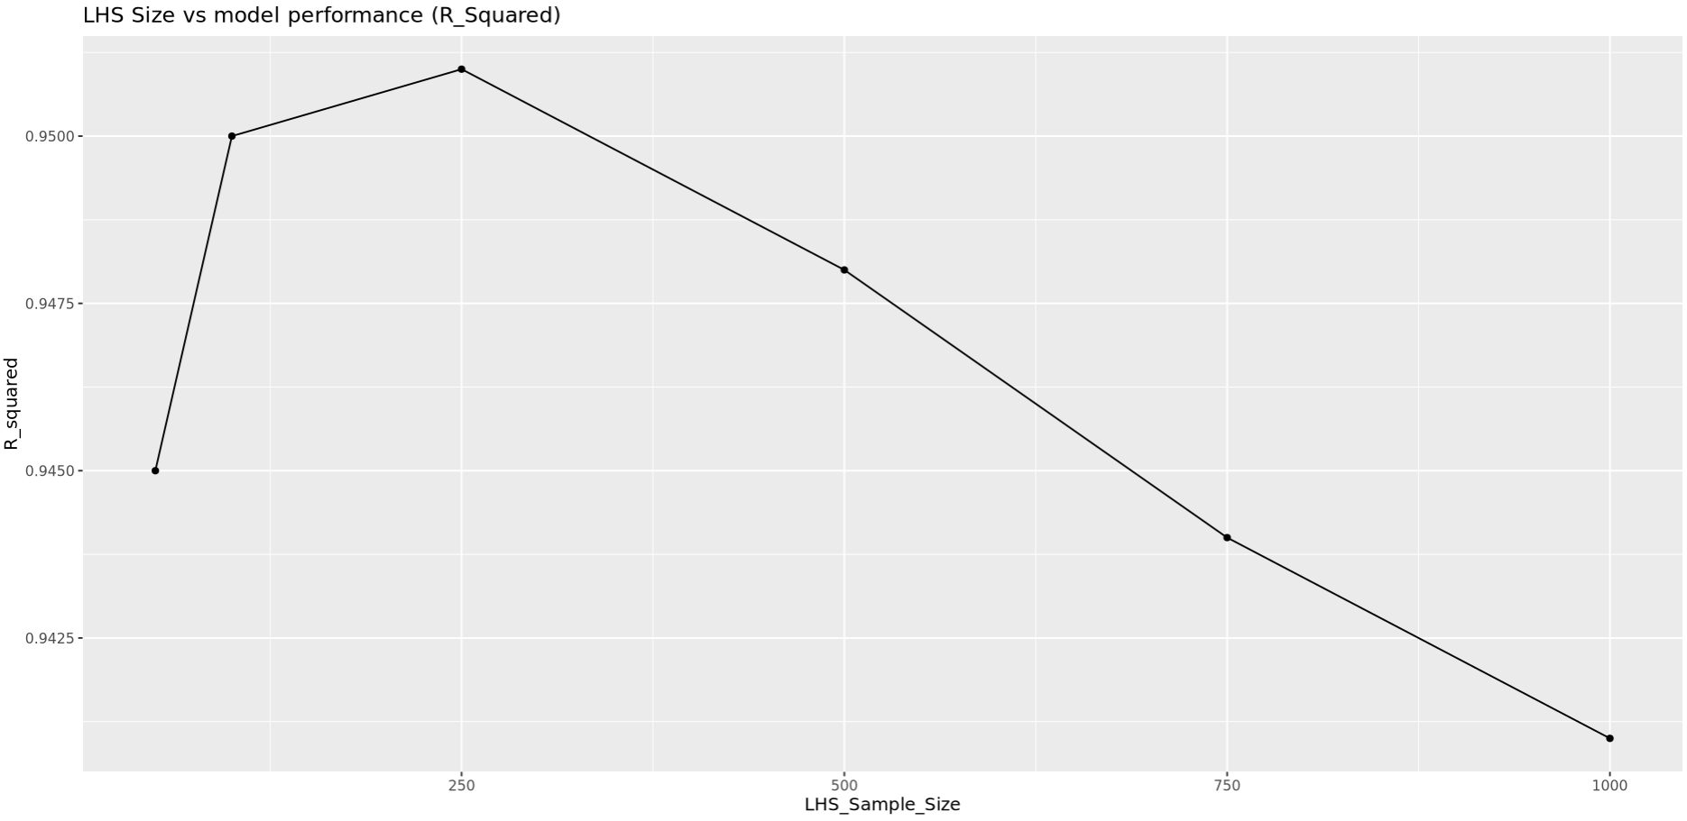
2 – GP performance evaluation - learning of prevalence reduction gives good statistical correspondence Actual vs predict using different LHS sample sizes for UE4
Notes:
LLINs is the most influential in determining the output variance

Slide 12
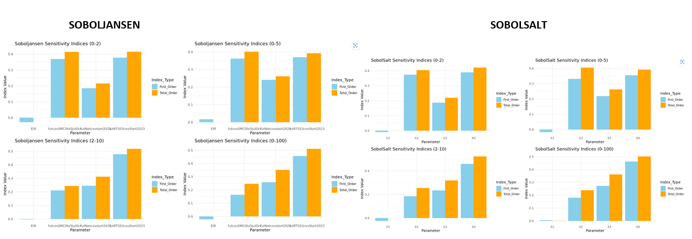
3 - Sobol methods comparison
Sobol sensitivity analysis of future coverages of malaria interventions for 3 settings in ghana: upper.EAST4, OTI and BONO.East.
Notes:
LLINs is the most influential in determining the output variance

Slide 13
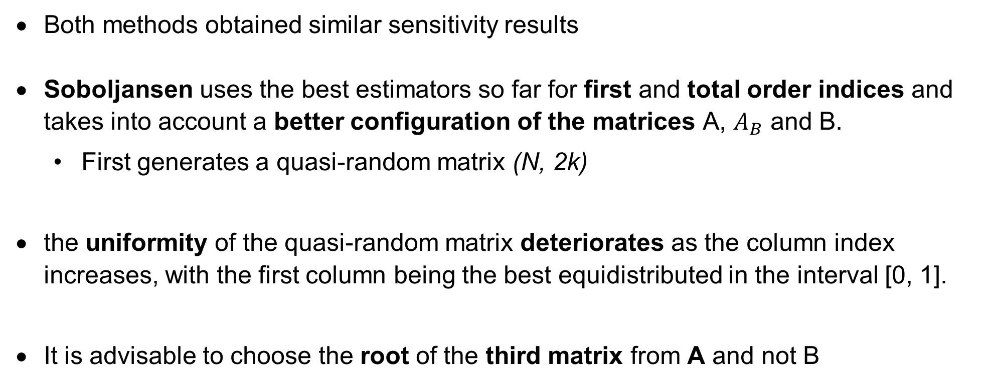
3 - Sobol methods comparison
Both methods obtained similar sensitivity results
Soboljansen uses the best estimators so far for first and total order indices and takes into account a better configuration of the matrices A, $A_{B}$ and B.
First generates a quasi-random matrix (N, 2k)
the uniformity of the quasi-random matrix deteriorates as the column index increases, with the first column being the best equidistributed in the interval [0, 1].
It is advisable to choose the root of the third matrix from A and not B
Model performance was evaluated using R-sqaured
Notes:
LLINs is the most influential in determining the output variance

Slide 14
3 - Sobol sensitivity analysis with setting-specific EIR and realistic intervention coverage ranges – APPROACH 1a
Train a GP model for each setting for 2-10 age_group, using EIR range (2-250) + deployed intervention coverage ranges
Sobol uses setting-specific EIR + realistic intervention coverage ranges of interventions to be deployed
Non-deployed interventions are indicated as NA on the plot
Parameter ranges:
futcovSMC0to5JulOct_min = 0.4, futcovSMC0to5JulOct_max = 0.9,
futRTSS3covStart2023_min = 0.5, futRTSS3covStart2023_max = 0.9,
futNetcovstart2021_min = 0.2, futNetcovstart2021_max = 0.8
Notes:
LLINs is the most influential in determining the output variance

Slide 15
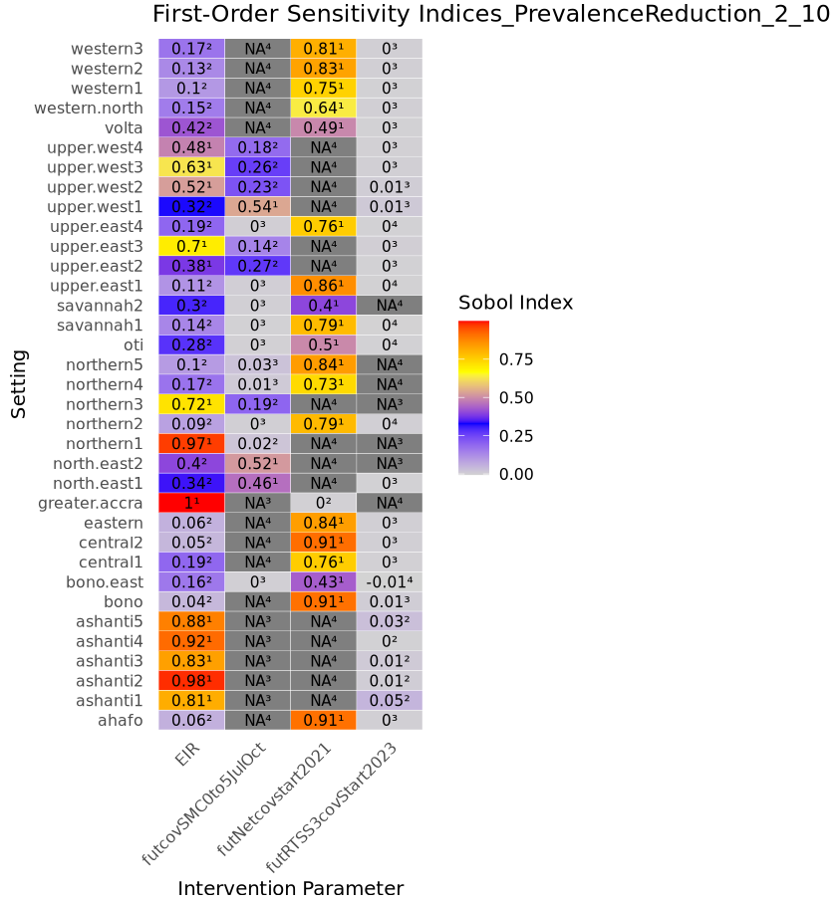
Sobol indices for 35 settings after integrating the above findings in the existing workflow
Sobol sensitivity results show the first order indices of intervention coverage which allows to rank for each setting which intervention is most sensitive to perturbation regarding the impact on prevalence reduction (by 2026).
In terms of prioritization, this work it gives us an idea of what interventions to keep and whether coverage should be high or not
We need to include vaccines for some settings
Policy question: where should we put our efforts? Is prev reduction more prone to loose impact if we maintain coverages of LLIN or SMC?
Get more realistic ranges for RTSS and others
Net2021 was the last campaign
Notes:
LLINs is the most influential in determining the output variance

Slide 16
3 - Sobol sensitivity analysis with setting-specific EIR and realistic intervention coverage ranges – APPROACH 2a
Train a GP model for each setting for 2-10 age_group, using EIR restricted to setting-specific range + deployed intervention coverage ranges
Setting specific EIR used mean EIR_CI values
Sobol Sensitivity analysis uses setting-specific EIR + realistic intervention coverage ranges of interventions to be deployed
Non-deployed interventions are indicated as NA on the plot
Parameter ranges:
futcovSMC0to5JulOct_min = 0.4, futcovSMC0to5JulOct_max = 0.9,
futRTSS3covStart2023_min = 0.5, futRTSS3covStart2023_max = 0.9,
futNetcovstart2021_min = 0.2, futNetcovstart2021_max = 0.8
Notes:
LLINs is the most influential in determining the output variance

Slide 17
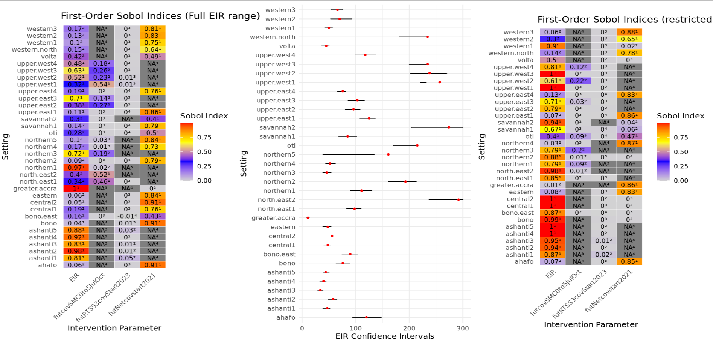
Sobol indices for 35 settings after integrating the above findings in the existing workflow – approach 2
Used average EIR_lci and uci values across subs as param ranges
Notes:
LLINs is the most influential in determining the output variance

Slide 18
3 - Sobol sensitivity analysis with setting-specific EIR and realistic intervention coverage ranges – APPROACH 1b
Train a GP model for each setting for 2-10 age_group, using EIR full range from OM outputs + deployed intervention coverage ranges
Setting specific EIR used min EIR_lci and EIR_uci values as param ranges
Sobol Sensitivity analysis uses setting-specific EIR + realistic intervention coverage ranges of interventions to be deployed
This is done for 2 different EIR calibration results (2010 and 2015)
Non-deployed interventions are indicated as NA on the plot
Parameter ranges:
futcovSMC0to5JulOct_min = 0.4, futcovSMC0to5JulOct_max = 0.9,
futRTSS3covStart2023_min = 0.5, futRTSS3covStart2023_max = 0.9,
futNetcovstart2021_min = 0.2, futNetcovstart2021_max = 0.8
Notes:
LLINs is the most influential in determining the output variance

Slide 19
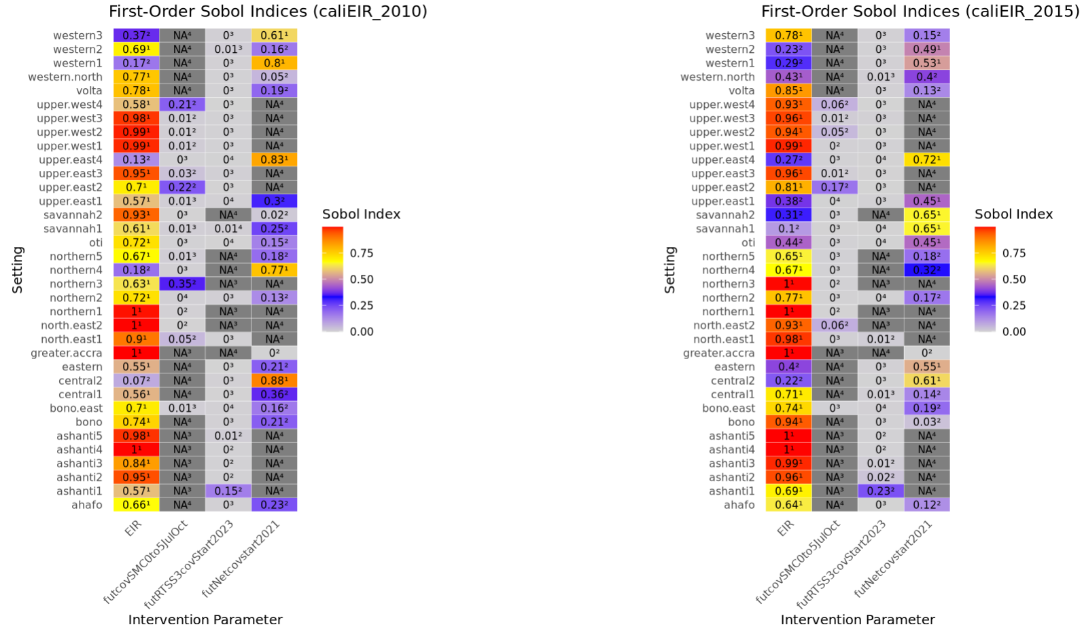
calibrationEIR_2010 and 2015
Train GP with full EIR range for each setting from OM outputs and run sobol sensitivity analysis using minimum EIR_LCI and maximum EIR_UCI across all subs per setting as the parameter range
Notes:
LLINs is the most influential in determining the output variance

Slide 20
UNCERTAINTY QUANTIFICATION OF AGENT-BASED MODELS WITH APPLICATION TO MALARIA INTERVENTION MODELING
PhD Update
March 2025

Slide 21
Sobol indices for 35 settings after integrating the above findings in the existing workflow – approach 2
Used average EIR_lci and uci values across subs as param ranges
Notes:
LLINs is the most influential in determining the output variance

Slide 22
2 – GP performance evaluation - learning of prevalence reduction gives good statistical correspondence LHS sample sizes for UE4 vs R-squared
Notes:
LLINs is the most influential in determining the output variance

Slide 23
Current setup for OM simulations and sensitivity analysis
Sample size of LHS = 250 instead of 100
Include IRS and CM
Train a GP model for each setting for 0-5 age_group, using EIR full range from OM outputs + deployed intervention coverage ranges
Setting specific EIR will use min EIR_lci and EIR_uci values across sub as param ranges
Sobol Sensitivity analysis uses setting-specific EIR + realistic intervention coverage ranges of interventions to be deployed
Non-deployed interventions are indicated as NA on the plot
Parameter ranges:
futcovSMC0to5JulOct_min = 0.4, futcovSMC0to5JulOct_max = 0.9,
futRTSS3covStart2023_min = 0.5, futRTSS3covStart2023_max = 0.9,
futNetcovstart2021_min = 0.2, futNetcovstart2021_max = 0.8
Notes:
LLINs is the most influential in determining the output variance

Slide 24
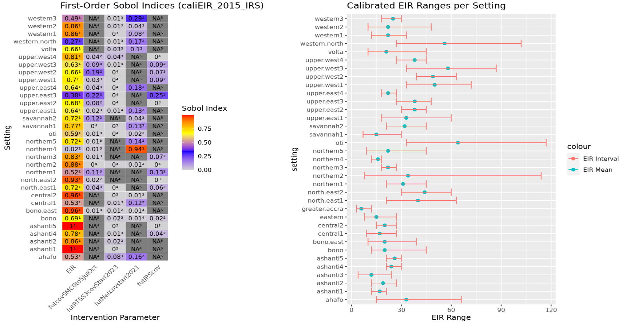
Sobol indices for 35 settings after integrating the above findings in the existing workflow
Notes:
LLINs is the most influential in determining the output variance

